Slide 1
Keys in DBMS
Dr. Anand Bihari
SJT Annex- 203N
anand.bihari@vit.ac.in

Slide 2
What are Keys?
A DBMS key is an attribute or set of an attribute which helps us to identify a row(tuple) in a relation(table).
In a real-world application, a table could contain thousands of records. Moreover, the records could be duplicated. Keys ensure that you can uniquely identify a table record despite these challenges.
They allow us to find the relation between two tables.
Keys help us to uniquely identify a row in a table by a combination of one or more columns in that table.
Help you to enforce identity and integrity in the relationship.

Slide 3
Keys in Database Management System
DBMS has following seven types of Keys each have their different functionality:
Super Key
Primary Key
Candidate Key
Alternate Key
Foreign Key
Compound Key
Composite Key
Surrogate Key

Slide 4
Super key
A Super key is a group of single or multiple keys which identifies rows in a table.
A Super key may have additional attributes that are not needed for unique identification.
Example:
Super Keys are
{EmpSSN}
{EmpNum}
{EmpSSN, EmpNum}
{EmpSSN, Empname}
{EmpNum, Empname}
{EmpSSN, EmpNum, Empname}
EmpSSN | EmpNum | Empname
9812345098 | AB05 | Shown
9876512345 | AB06 | Roslyn
199937890 | AB07 | James

Slide 5
Primary Key
A column or group of columns in a table which helps us to uniquely identifies every row in table is called a primary key.
The same value can't appear more than once in the table for primary key column.
Rules for defining Primary key:
Two rows can't have the same primary key value
It must for every row to have a primary key value.
The primary key field cannot be null.
The value in a primary key column can never be modified or updated if any foreign key refers to that primary key.

Slide 6
Candidate Key
The candidate keys in a table are defined as the set of keys that is minimal and can uniquely identify any data row in the table.
The Primary key should be selected from the candidate keys.
Every table must have at least one candidate key.
Properties of Candidate key:
It must contain unique values
Candidate key may have multiple attributes
Must not contain null values
It should contain minimum fields to ensure uniqueness
Uniquely identify each record in a table

Slide 7
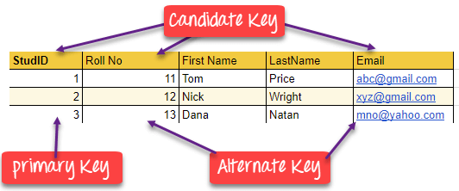

Slide 8
Super key vs Candidate Key
All the candidate keys are super keys.
This is because the candidate keys are chosen out of the super keys.
How we choose candidate keys from the set of super keys?
The keys from which cannot remove any fields. In the first example, we have not chosen {Emp_SSN, Emp_Name} as candidate key because {Emp_SSN} alone can identify a unique row in the table and Emp_Name is redundant.

Slide 9
Alternate key
All the keys which are not primary key are called an alternate key.
It is a candidate key which is currently not the primary key.
However, A table may have single or multiple choices for the primary key.

Slide 10
Foreign key
A foreign key is an attribute value in a table that acts as the primary key in another table.
Hence, the foreign key is useful in linking together two tables.
Data should be entered in the foreign key column with great care, as wrongly entered data can invalidate the relationship between the two tables.

Slide 11
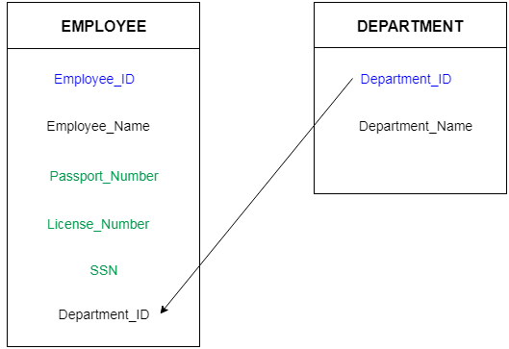

Slide 12
Compound key
Compound key is the set of key attributes that allows us to uniquely recognize a specific record.
It is possible that each column may be not unique by itself within the database.
However, when combined with the other column or columns the combination of composite keys become unique.

Slide 13
Composite key
A key which has multiple attributes to uniquely identify rows in a table is called a composite key.
The difference between compound and the composite key is that any part of the compound key can be a foreign key, but the composite key may or maybe not a part of the foreign key.
OrderNo | PorductID | Product Name | Quantity
B005 | JAP102459 | Mouse | 5
B005 | DKT321573 | USB | 10
B005 | OMG446789 | LCD Monitor | 20
B004 | DKT321573 | USB | 15
B002 | OMG446789 | Laser Printer | 3

Slide 14
Surrogate Key
An artificial key which aims to uniquely identify each record is called a surrogate key.
These kind of key are unique because they are created when you don't have any natural primary key.
They do not lend any meaning to the data in the table.
Surrogate key is usually an integer.
Above, given example, shown shift timings of the different employee.
In this example, a surrogate key is needed to uniquely identify each employee.
Fname | Lastname | Start Time | End Time
Anne | Smith | 09:00 | 18:00
Jack | Francis | 08:00 | 17:00
Anna | McLean | 11:00 | 20:00
Shown | Willam | 14:00 | 23:00

